Slide 1
Components React Native

Slide 2
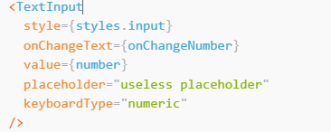
TextInput
A foundational component for inputting text into the app via a keyboard.
Props:
value
autoComplete(android)
autoCorrect
onChangeText

Slide 3

Switch
This is a controlled component that requires an onValueChange callback that updates the value prop in order for the component to reflect user actions.
Props
Disabled
onValueChange
thumbColor (foreground switch)
value

Slide 4
FlatList
For rendering basic flat lists
Props
renderItem (required)
Data (required)
keyExtractor
ListEmptyComponent
ListFooterComponent
ListFooterComponentStyle

Slide 5
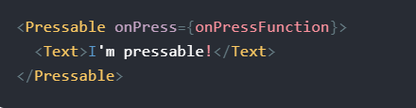
Pressable
Pressable is a Core Component wrapper that can detect various stages of press interactions on any of its defined children.
Working
onPressIn is called when a press is activated.
onPressOut is called when the press gesture is deactivated.
After pressing onPressIn, one of two things will happen:
The person will remove their finger, triggering onPressOut followed by onPress.
If the person leaves their finger longer than 500 milliseconds before removing it, onLongPress is triggered. (onPressOut will still fire when they remove their finger.)

Slide 6
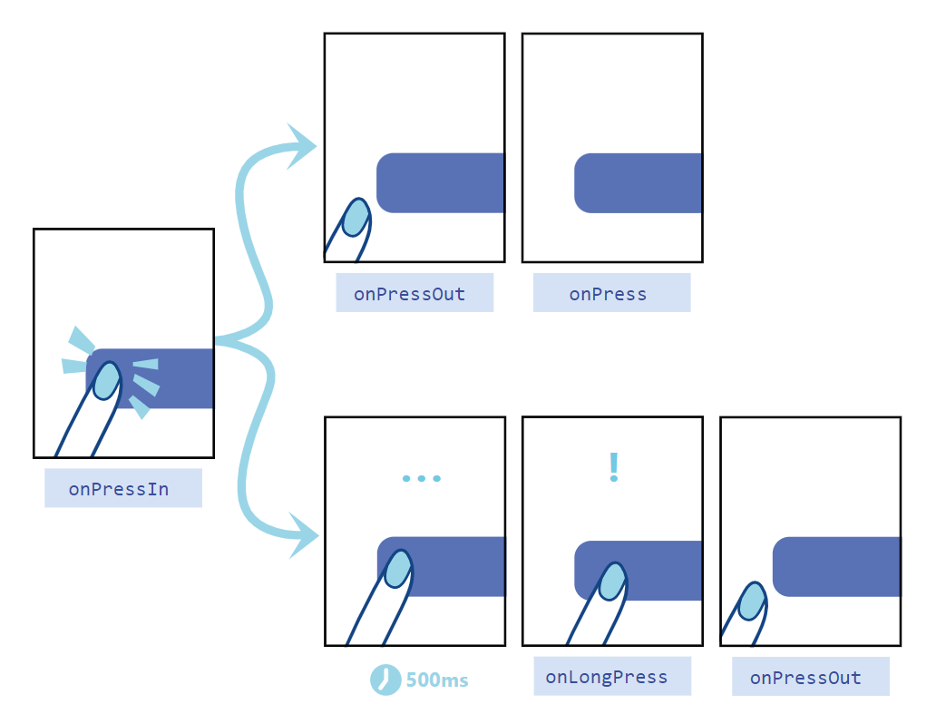

Slide 7
Pressable
HitRect you can use to define how far a touch can register away from the wrapped element.

Slide 8
References
[1] https://reactnative.dev/docs/textinput
[2] https://reactnative.dev/docs/switch
[3] https://reactnative.dev/docs/flatlist

